Slide 1

长江汽车电子MES系统方案
群电同津厂
TPMS Architecture Training
2020-11-30

Slide 2
Topic
IT交接内容 | 测试平台，测试剧本，各server的检查，架构，平台数据关系维运注意事项，平台report开发
Hyper-V 2019 转VMware
TPMS 系统冗余/HA 机制
数据后台修改需求?

Slide 3
系统部署配置
Host-1:
Host-2:
硬体
1.CPU: 5117*2
2.Memory：128G
3.Network：万兆网卡*4
4.Storage：2T 10K SAS*3, 300G SSD*2
软体
Microsoft Hyper-V Server 2019(Client:Win10 Hyper-V Manager)
Ubuntu 18.04
MongoDB4.2.3、Postgres、InfluxDB
NodeJS 8.9.4/Python2.7.17
Nginx 1.10.3
RabbitMQ/MQTT
Grafana/Telegraf/Kettle
TPMS
IOT Devices
2 PLC网关 Per Line
PLC转换模块
VM1-1: IotServer1
OS: Ubuntu 18.05/Telegraf 1.10.4/Grafana/
Python:2.7.17/NodeJS v8.11.1
TV(AMS Kanban)/
DM(AMS Data Manager)
/DataRecord/TSDBService
VM2-1: IotMonitor1
OS: Ubuntu 18.05/Telegraf 1.10.4
Python:2.7.17
Alarm/DeviceStatus/
AppService/
OEE/BusAnnounce/SPC
VM1-2: DeviceSpare
OS: Ubuntu 18.05/Telegraf 1.10.4
Nginx 1.14.0/NodeJS 8.9.4
GraphicsMagick 1.3.23
TPM Dbus/Device/Spare/Alarm/guard/safe
VM2-2: Mongodb
OS: Ubuntu 18.05/Telegraf 1.10.4
MongoDB4.2.6(PRIMARY)
VM1-3: PG
OS: Ubuntu 18.05/Telegraf 1.10.4
MongoDB4.2.6(SECONDARY)
PostgreSQL/Kettle
VM2-3: InfluxDB
OS: Ubuntu 18.05/Telegraf 1.10.4
MongoDB4.2.6(SECONDARY Hidden)
InfluxDB
VM1-4: esb1
OS: Ubuntu 18.05/Telegraf 1.10.4
Hazelcast/
KeepAlived/RabbitMQ
VM2-4: esb2
OS: Ubuntu 18.05/Telegraf 1.10.4
Hazelcast/
KeepAlived/RabbitMQ

Slide 4
软件环境
Machine Name | OA IP | Internal IP | Component | Hardware
IotServer1 | 172.25.57.231 | 10.4.100.231 | TV/DM/DataRecord/TSDBService/Alarm/DeviceStatus/AppService/OEE/BusAnnounce/SPC/Telegraf | cpu:16cores dimm:10G OS HDD:50G ssd
IotMonitor1 | 172.25.57.232 | 10.4.100.232 | Agents
DeviceSpare | 172.25.57.233 | 10.4.100.233 | TPM Dbus/Device/Spare/Alarm/guard/safe/Nginx/Telegraf
Mongodb | 172.25.57.234 | 10.4.100.234 | MongoDB4.2.6/Telegraf
PG | 172.25.57.235 | 10.4.100.235 | MongoDB4.2.6/PostgreSQL/Kettle/Drkon/etcd/Telegraf
Influxdb | 172.25.57.236 | 10.4.100.236 | MongoDB4.2.6/InfluxDB/Grafana/Telegraf
esb1 | 172.25.57.237 vip:172.25.57.239 | 10.4.100.237 vip:10.4.100.239 | Hazelcast/jre1.8/KeepAlived/RabbitMQ/Telegraf
esb2 | 172.25.57.238 vip:172.25.57.239 | 10.4.100.238 vip:10.4.100.239 | Hazelcast/jre1.8/KeepAlived/RabbitMQ/Telegraf

Slide 5
TPM模块图
Dbus Service
Device Service
TV Kanban
IoT Agent
PLC Gateway
Alarm Service
OEE Service
工控机Gateway
TPM DB
(MongoDB)
DM Service
Device Status
AMS MemDB
(Hazelcast)
Rabbit MQ
Data Recorder
TSDB Recorder
Spare Service
Kettle
AMS DB
(PostgreSQL)
TPMS Kanban
AMS TSDB
(InfluxDB)
Telegraf
Guard Service
Safe Service
TPMS Resource Monitor

Slide 6
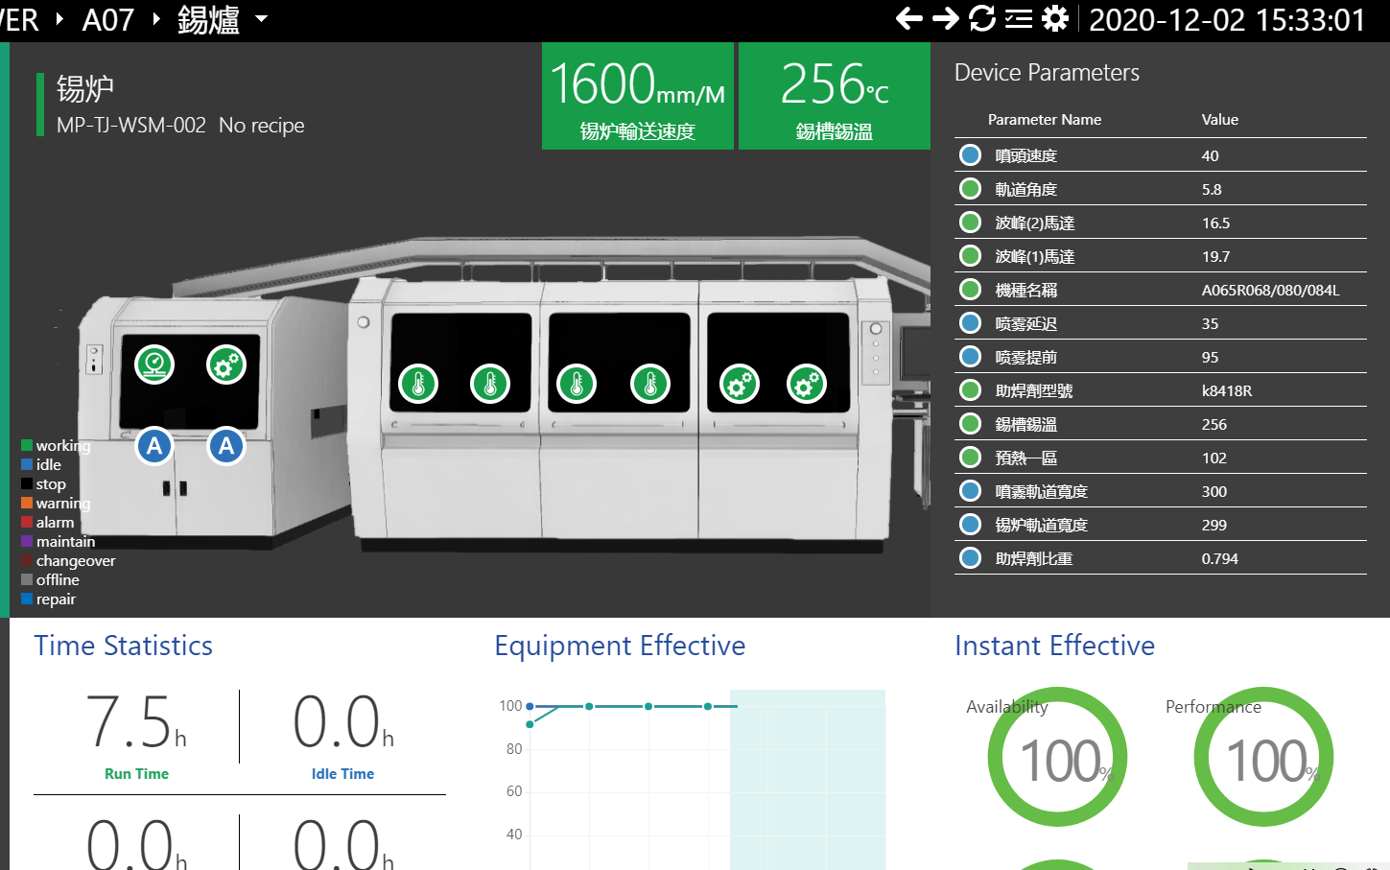
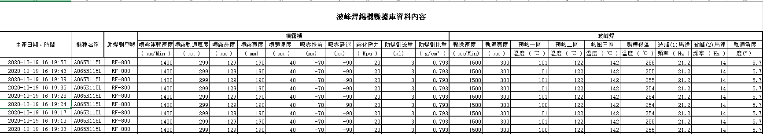
锡炉监控方案(log)
TV Kanban
RawData
(InfluxDB)
AMS DB
(PG)
OEE Service
Param Monitor
Device Status
TSDB Recorder
Data Recorder
Alarm Service
DM
Service
RabbitMQ
Event/Data(10s)
WSM Agent
WSM Agent Query (10s)
锡炉工控机
Log Files
Output Log(30s)

Slide 7
IOT Deployment in Chicony Product Line
線體 | 站點 | 設備數量 | Switch Port | Mac | IP | 物理接線 | 機台入網狀態 | Log輸出或PLC接入 | TPMS監控
A07 | 插件機 | 1 | 2F7-D006 | B4-96-91-5B-B3-10 | 10.4.92.61 | Done | Done | Log Done | Done
 | 錫爐 | 1 | 2F7-D010 | 04-0E-3C-2B-15-2B | 10.4.92.62 | Done | Done | Log Done | Done
 | 前移載 | 1 | 2F7-D062 |  | PLC网关 LAN1:10.4.92.63 2F7-D062 LAN2:192.168.3.232 | Done | Done | PLC Done | Done
 | AOI | 1 | 2F7-D061 | 00-19-0F-43-4B-49 | 10.4.92.64 | Done | Done | Log Done | Done
 | ICT | 2 | 2F7-D062 |  | PLC网关 LAN1:10.4.92.63 2F7-D062 LAN2:192.168.3.232 | Done | Done | PLC Done | Done
 | ACT | 2 | 2F7-D062 |  | PLC网关 LAN1:10.4.92.63 2F7-D062 LAN2:192.168.3.232 | Done | Done | PLC Done | Done
 | 後移載 | 1 | 2F7-D062 |  | PLC网关 LAN1:10.4.92.63 2F7-D062 LAN2:192.168.3.232 | Done | Done | PLC Done | 監控程式OK。待停線廠商更新PLC程式
 | 組裝 | 16 | 2F7-D023 | C4-00-AD-5A-4E-24 | 10.4.92.65 | Done | Done | Log Done | Done
 | 超音波 | 1 | 2F7-D063 | 00-E2-69-2B-EC-93 | 10.4.92.66 | Done | Done | Log Done | Done
 | BurnIn | 4 | 2F7-D066 |  | PLC网关10.4.92.67 LAN1:10.4.92.67 2F7-D068 LAN2:192.168.3.233 2F7-D067 | Done | Done | PLC Done | Done
 | PD測試 | 1 | 2F7-D067 |  | PLC网关10.4.92.67 LAN1:10.4.92.67 2F7-D068 LAN2:192.168.3.233 2F7-D067 | Done | Done | PLC Done | Done
 | Mapping | 1 | 2F7-D069 |  | PLC网关10.4.92.67 LAN1:10.4.92.67 2F7-D068 LAN2:192.168.3.233 2F7-D067 | Done | Done | PLC Done | 監控程式OK。待停線廠商更新PLC程式

Slide 8
IOT Deployment in Chicony Product Line
線體 | 站點 | 設備數量 | Switch Port | Mac | IP | 物理接線 | 機台入網狀態 | Log輸出或PLC接入 | TPMS監控
A01 | 錫爐 |  | 2F1-D010 | 00-E0-4C-68-9D-9B | 10.4.92.1 | Done | Done | Log Done | Done
 | 前移載 | 1 | 2F1-D063 |  | PLC网关 LAN1:10.4.92.2 2F1-D063 LAN2: 192.168.3.230 | Done | Done | PLC Done | 監控程式OK。待停線廠商更新PLC程式
 | AOI |  | 2F1-D062 | 00-1B-21-C9-8C-20 | 10.4.92.3 | Done | Done | Log Done
 | ICT | 2 | 2F1-D063 |  | PLC网关 LAN1:10.4.92.2 2F1-D063 LAN2:192.168.3.230 | Done | Done | PLC Done
 | ACT | 2 | 2F1-D063 |  | PLC网关 LAN1:10.4.92.2 2F1-D063 LAN2:192.168.3.230 | Done | Done | PLC Done
 | 後移載 | 1 | 2F1-D063 |  | PLC网关 LAN1:10.4.92.2 2F1-D063 LAN2:192.168.3.230 | Done | Done | PLC Done
 | 組裝 | 22 | 2F1-D021 | C4-00-AD-44-89-B3 | 10.4.92.4 | Done | Done | Log Done | Done
 | 超音波 | 1 | 2F1-D026 | 00-E2-69-27-4B-F8 | 10.4.92.5 | 已接入RS232轉網絡模塊，可抓取數據；待安裝供電插板
 | 超音波 | 1 | 2F1-D027 | 00-E2-69-27-5D-35 | 10.4.92.7 | 已接入RS232轉網絡模塊，可抓取數據；待安裝供電插板
 | 上机站 | 1 | 2F1-D065 |  | PLC网关 LAN1:10.4.92.6 2F1-D066 LAN2:192.168.3.231 2F1-D065 | Done | Done | Log Done | Done
 | BurnIn | 1 | 2F1-D065 |  | PLC网关 LAN1:10.4.92.6 2F1-D066 LAN2:192.168.3.231 2F1-D065 | Done | Done | Log Done | Done
 | PD測試 | 1 | 2F1-D065 |  | PLC网关 LAN1:10.4.92.6 2F1-D066 LAN2:192.168.3.231 2F1-D065 | Done | Done | Log Done | Done

Slide 9
IOT Deployment in Chicony Product Line
線體 | 站點 | 設備數量 | Switch Port | Mac | IP | 物理接線 | 機台入網狀態 | Log輸出或PLC接入 | TPMS監控
A08 | 錫爐 |  | 2F8-D010 | 04-0E-3C-28-5E-0B | 10.4.92.72 | Done | Done | Log Done | Done
 | 超音波 |  | 2F8-D061 | 00-E2-69-2B-D3-E3 | 10.4.92.76 | Done | Done | 待與設備工程師設定輸出及開啟共享
A09 | 錫爐 |  | 2F9-D010 | 04-0E-3C-2B-15-92 | 10.4.92.82 | Done | Done | Log Done | Done
 | 超音波 |  |  |  |  | 設備老舊，待更換
A10 | 錫爐 |  | 2F10-D010 | 04-0E-3C-28-5E-61 | 10.4.92.92 | Done | Done | Log Done | Done
 | 超音波 |  | 2F10-D061 | 00-E2-69-2B-EC-AF | 10.4.92.96 | Done | Done | 待與設備工程師設定輸出及開啟共享
A11 | 錫爐 |  | 2F11-D010 | 04-0E-3C-2B-13-D5 | 10.4.92.102 | Done | Done | Log Done | Done
 | 超音波 |  | 2F11-D028 | 00-E2-69-2B-D3-23 | 10.4.92.106 | Done | Done | 待與設備工程師設定輸出及開啟共享
A12 | 錫爐 |  | 2F12-D010 | 04-0E-3C-2B-15-F0 | 10.4.92.112 | Done | Done | Log Done | Done
 | 超音波 |  | 2F12-D028 | 00-E2-69-28-8E-A6 | 10.4.92.116 | Done | Done | 待與設備工程師設定輸出及開啟共享

Slide 10
IOT Deployment in Chicony Product Line
線體 | 站點 | 設備數量 | Switch Port | Mac | IP | 物理接線 | 機台入網狀態 | Log輸出或PLC接入 | TPMS監控
T01 | 绕线 | 7 |  |  | PLC网关 LAN1:172.25.11.1 LAN2:192.168.100.100 | Done | Done | PLC Done | Done
 | 中转架台 | 1 |  |  |  | Done | Done | PLC Done | Done
 | 激光剥皮 | 2 |  |  |  | Done | Done | PLC Done | Done
 | 锡炉 | 2 |  |  |  | Done | Done | PLC Done | Done
 | 高压机 | 2 |  |  |  | Done | Done | PLC Done | Done
 | 综合测试 | 2 |  |  |  | Done | Done | PLC Done | Done
 | 摆盘机 | 1 |  |  |  | Done | Done | PLC Done | Done
 | 外壳组装 | 2 |  |  | PLC网关 LAN1:172.25.11.2 LAN2:192.168.100.101 | Done | Done | PLC Done | Done
 | 分拣机台 | 2 |  |  |  | Done | Done | PLC Done | Done
 | ATE | 2 |  |  |  | Done | Done | PLC Done | Done
 | 包装 | 1 |  |  |  | Done | Done | PLC Done | Done

Slide 11
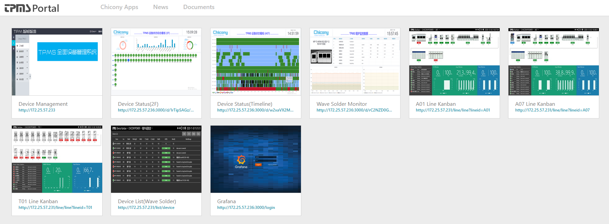
TPMS Portal
Portal Url:
OA: http://172.25.57.231
Internal: http://10.4.100.232

Slide 12
Hyper-V Server 2019管理
参考URL
https://blog.csdn.net/weixin_30293135/article/details/101113957
https://blog.csdn.net/pkgfs/article/details/107090378
服务端操作 （Hyper-V Server 2019）
1、服务器开启后，配置计算机名、配置远程管控功能开启、远程桌面开启、ip地址固定
2、使用powershell命令，开启credssp
C:\Users\Administrator>powershell
PS C:\Users\Administrator> Enable-PSRemoting PS C:\Users\Administrator> Enable-WSManCredSSP -role server
3、关闭防火墙：
PS C:\Users\Administrator> netsh advfirewall set currentprofile state off
客户端操作 （Win10）
1、启用Hyper-V管理工具
2、修改hosts文件：如192.168.100.100 hyper-v-server
3、客户端工作组不能为“公用”
Win-设置-网络和Internet-状态-更改连接属性，公用改为“专用”
4、修改组策略
gpedit.msc----本地计算机策略----管理工具----系统----凭证分配：允许分配新的凭证用于仅NTLM服务器身份验证
启用并添加一行值：wsman/HYPER-V-SERVER
5、powershell执行命令：
开启winrm：winrm quickconfig
winrm安全配置：Set-Item WSMan:\localhost\Client\TrustedHosts -Value "HYPER-V-SERVER"
winrm身份验证配置：Enable-WSManCredSSP -Role client -DelegateComputer "HYPER-V-SERVER"

Slide 13
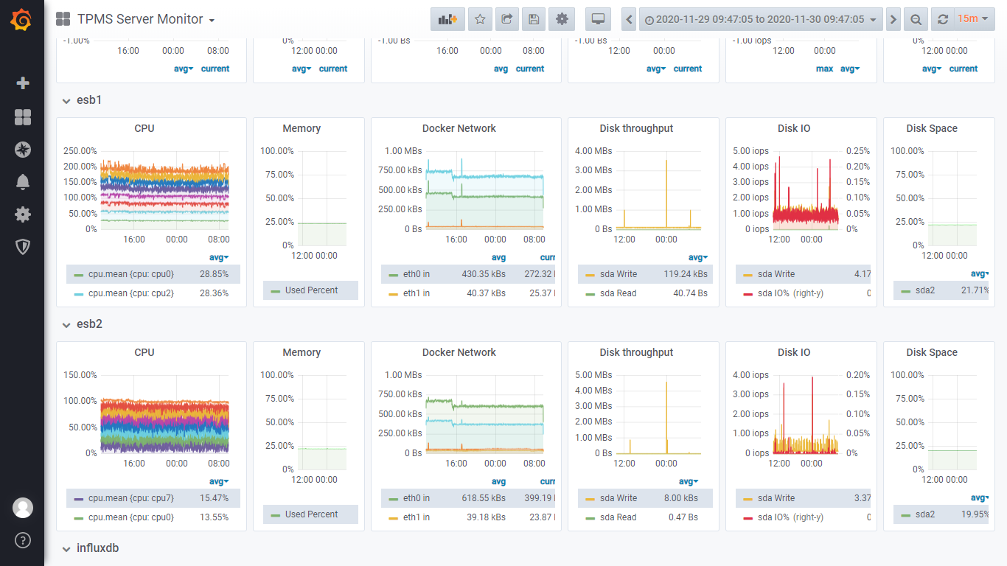
TPMS Server Monitor
Telegraf上报资源数据
Grafana Kanban
http://172.25.57.236:3000/d/7asd4fa567sd4/tpms-server-monitor

Slide 14
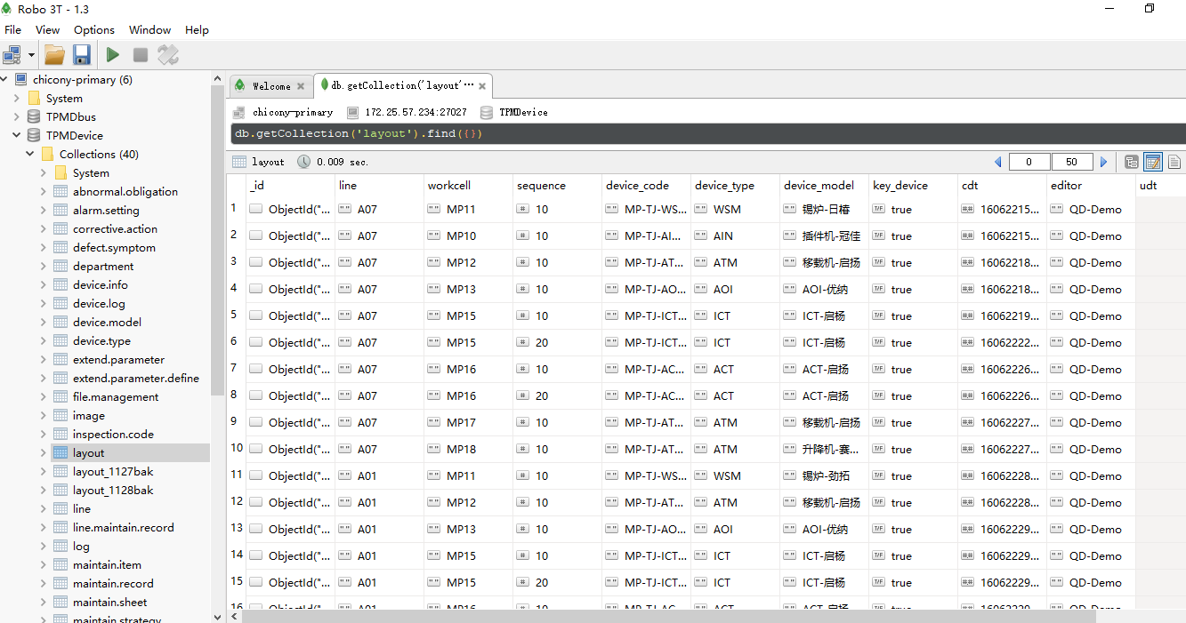
Database Management
MongoDB 4.2.6, Robo 3T 1.3.1管控

Slide 15
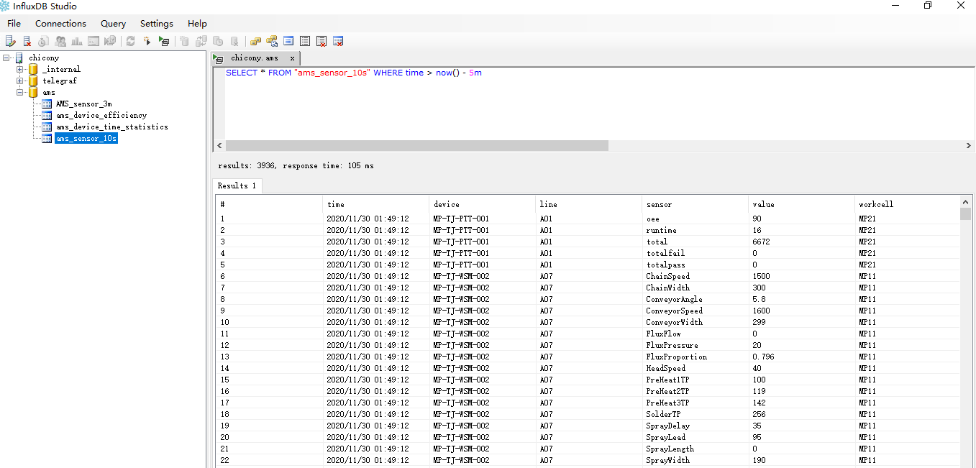
Database Management
InfluxDB 1.7.9, InfluxDBStudio-0.1.0管控

Slide 16
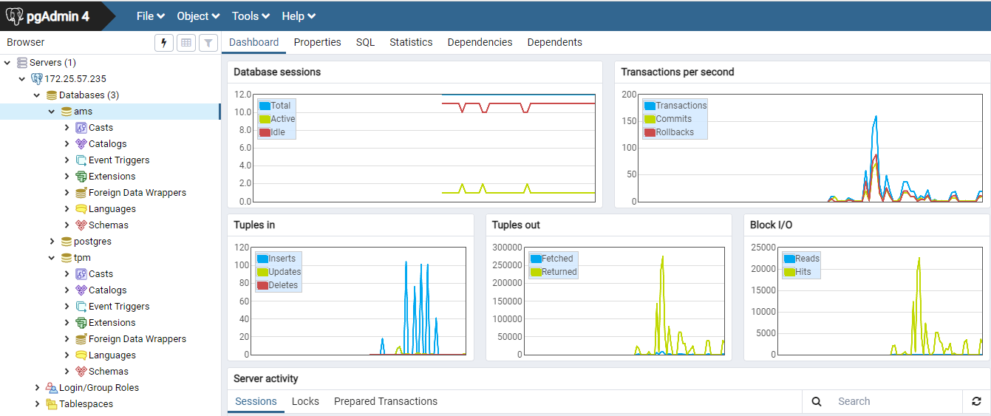
Database Management
Postgres 11.8, PGAdmin4.3管控

Slide 17


